Slide 1
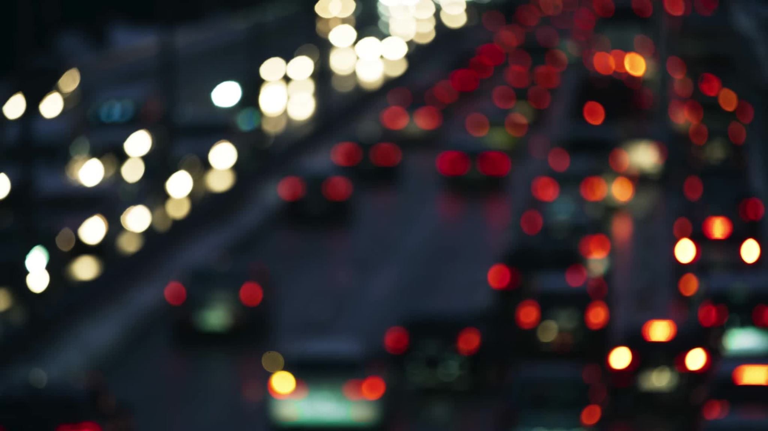
Chicago Traffic Crashes
By Srikanth Siddamsetty
Saicharan Kolluru

Slide 2
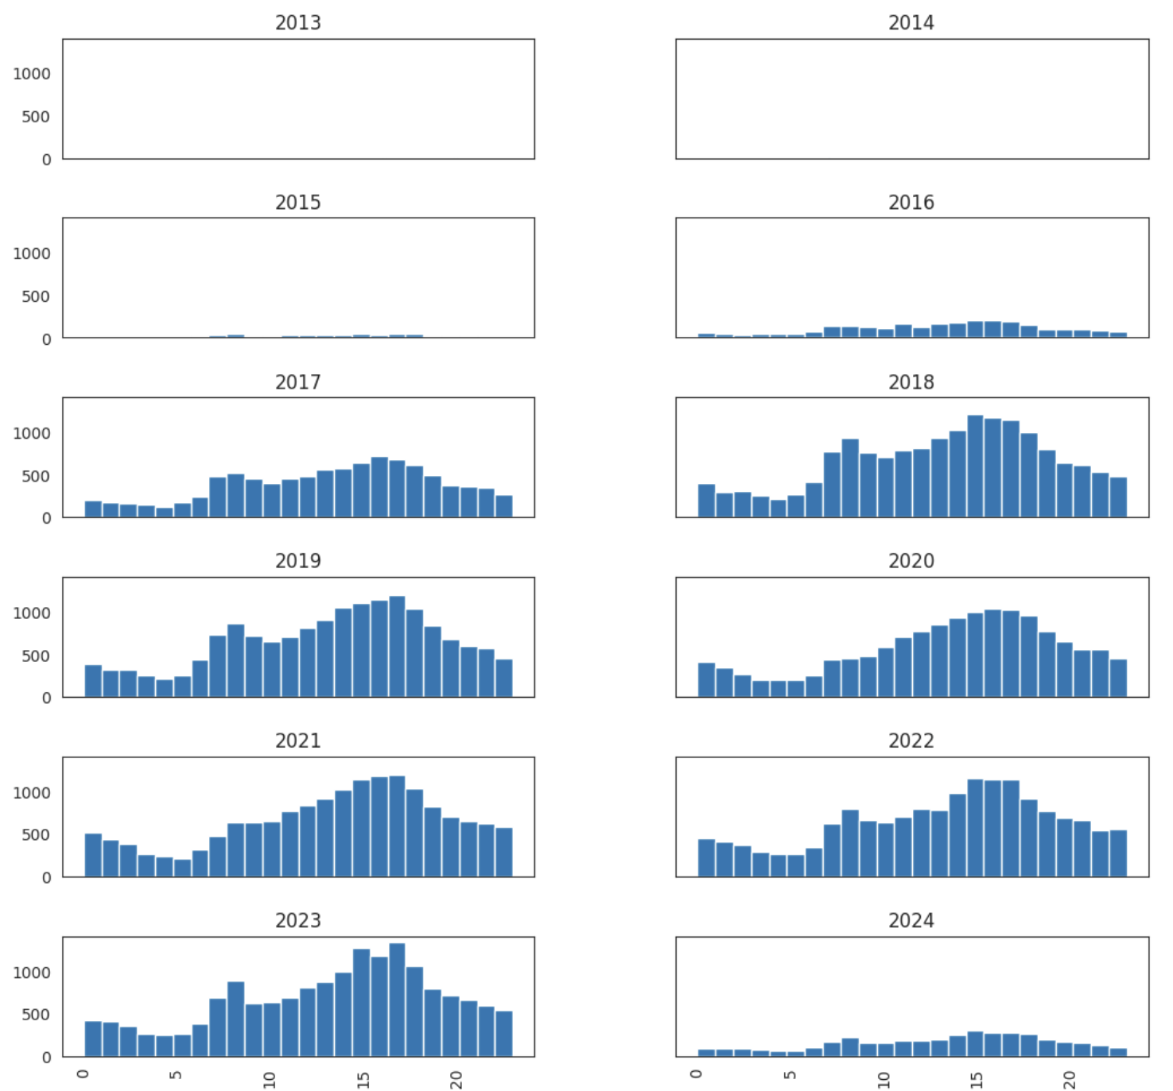
Crash Analysis that has Injuries

Slide 3
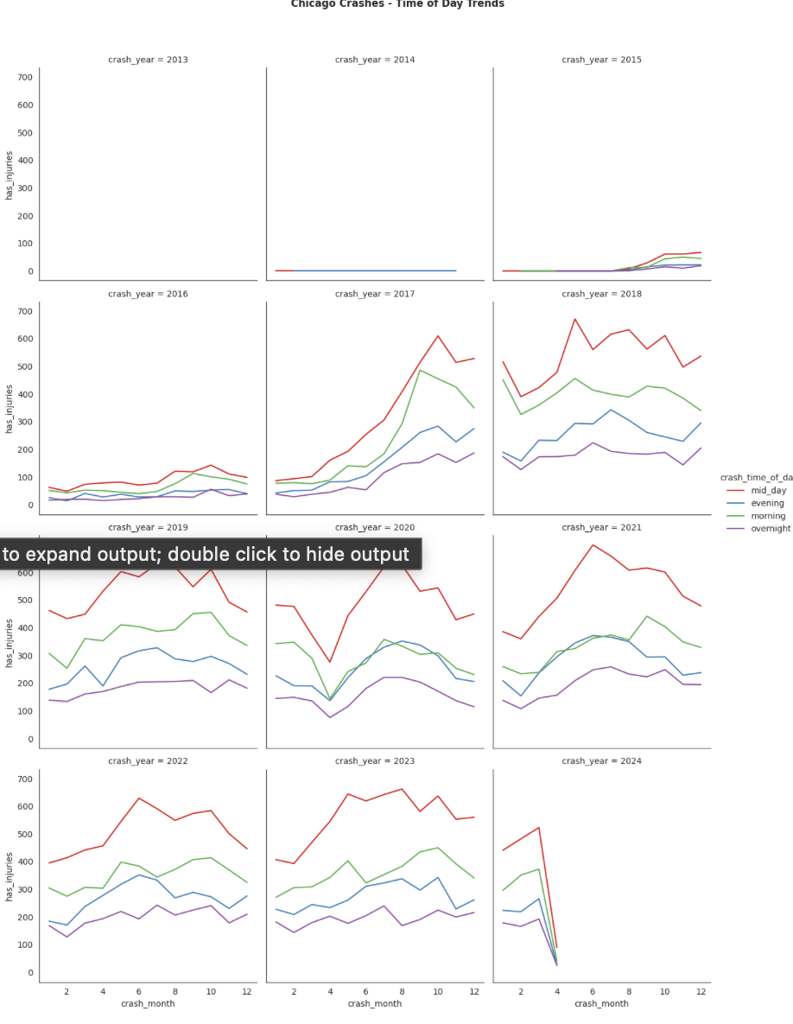
Chicago Crashes - Time of Day Trends

Slide 4
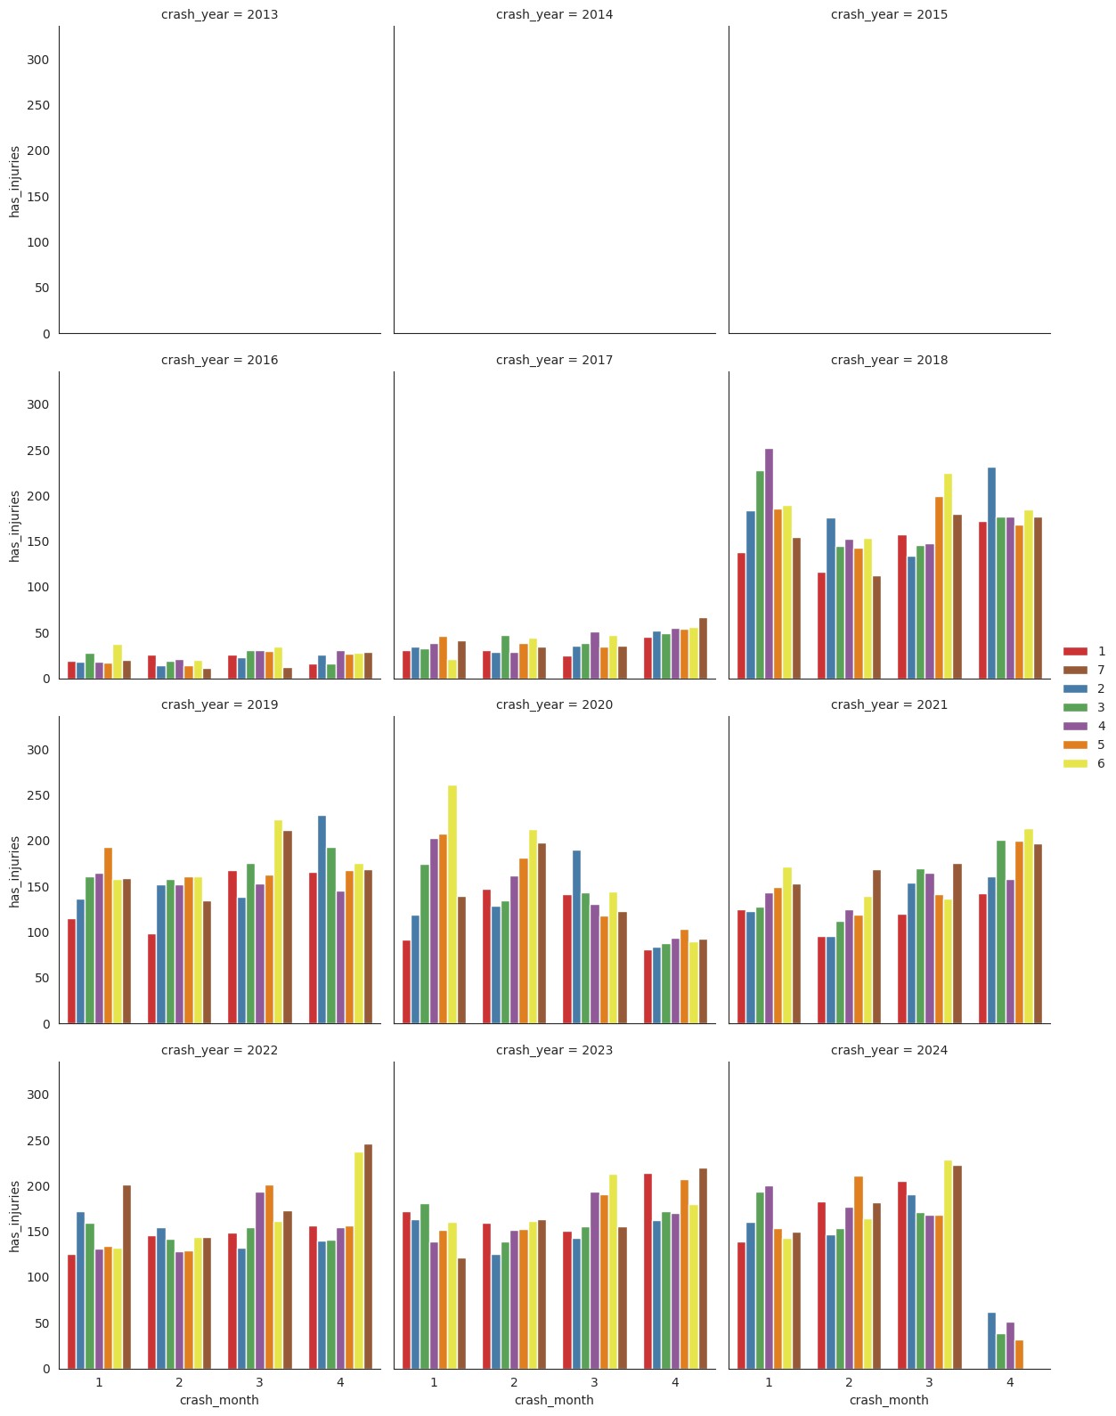
Number of injuries for each month, differentiated by the day of the week, for each year in the dataset.

Slide 5
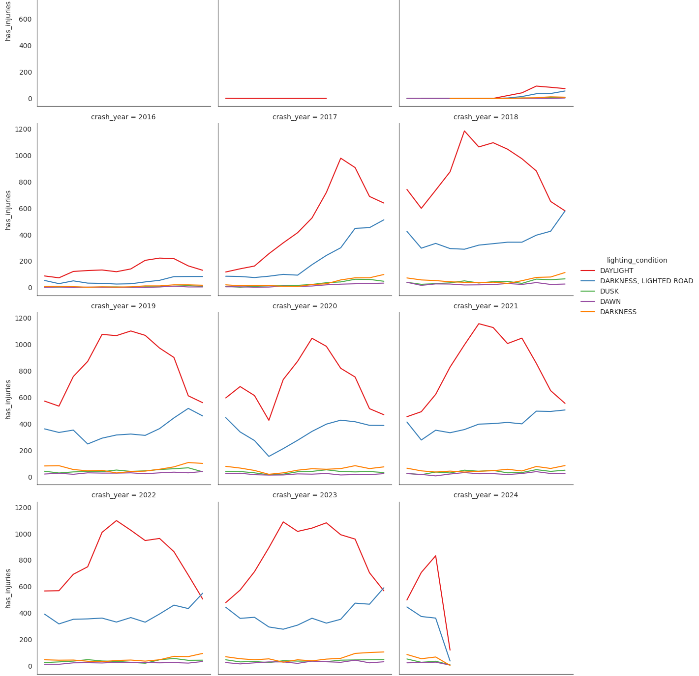
Chicago Crashes - Lighting Condition Trends

Slide 6
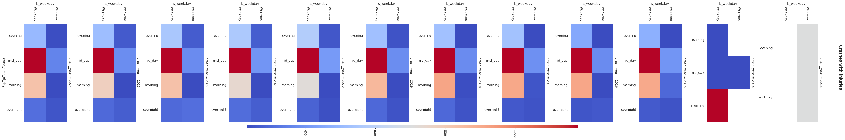
Crashes with Injuries

Slide 7
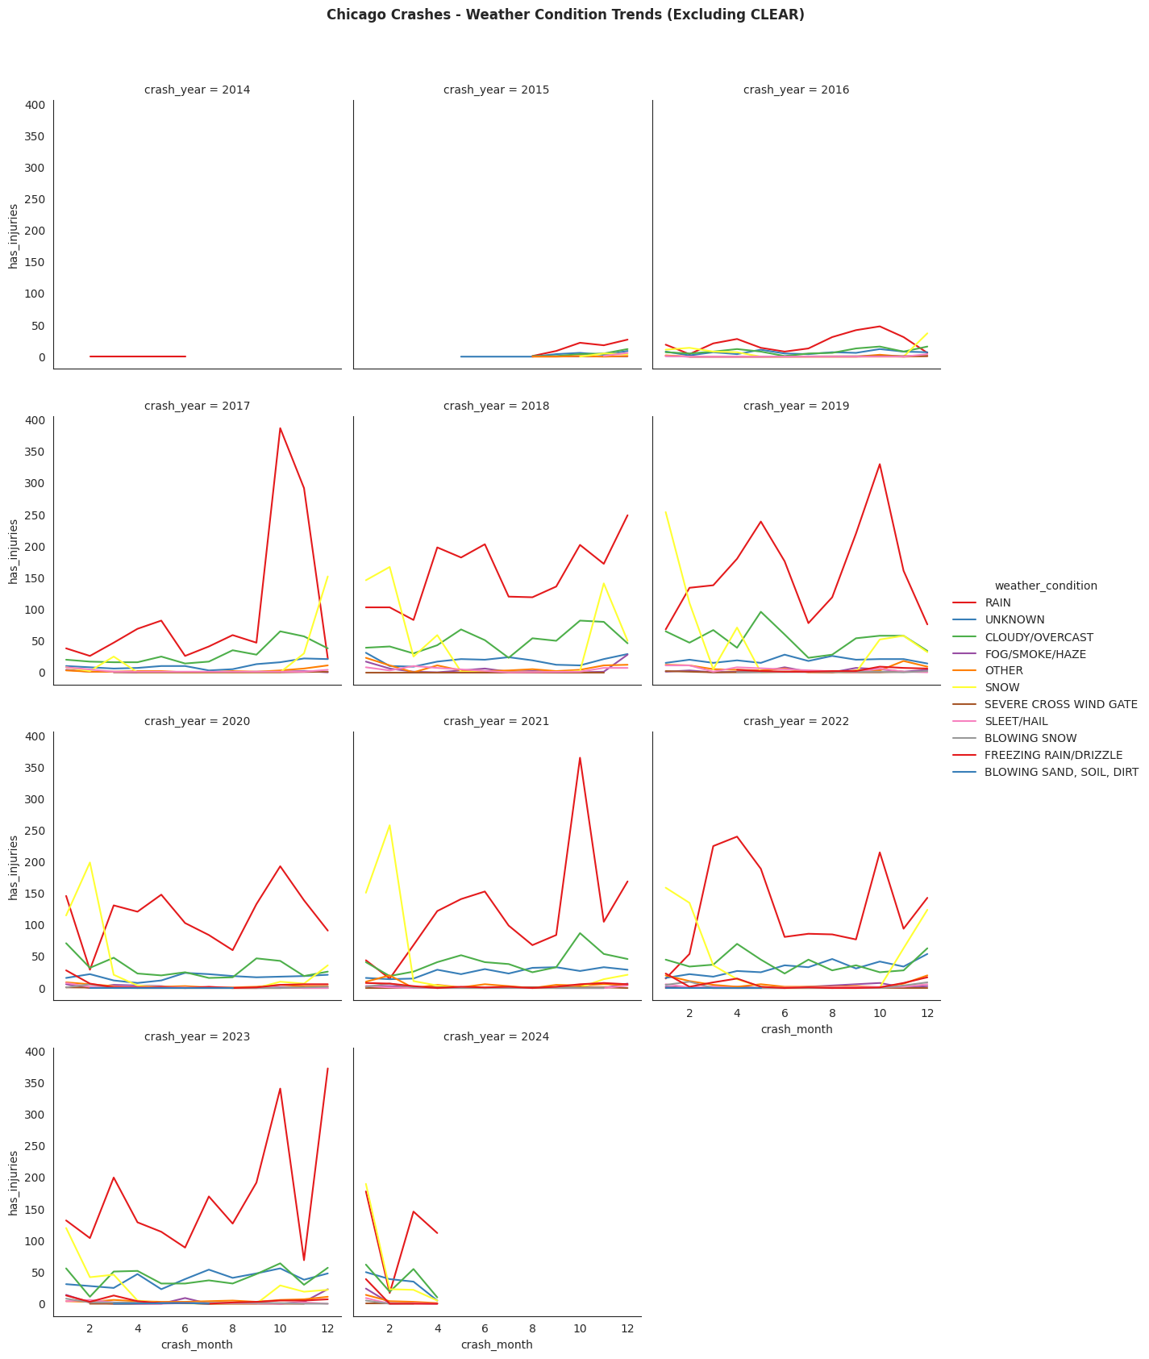
Weather Conditions excluding CLEAR

Slide 8
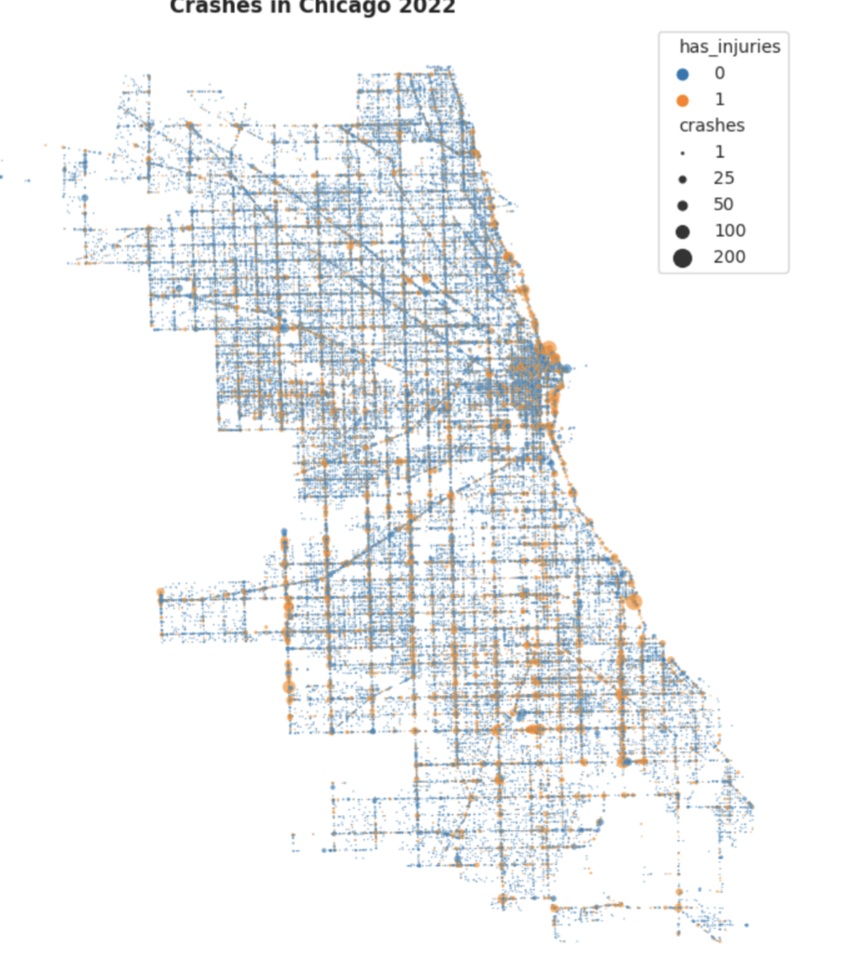
Crashes in Chicago 2022

Slide 9
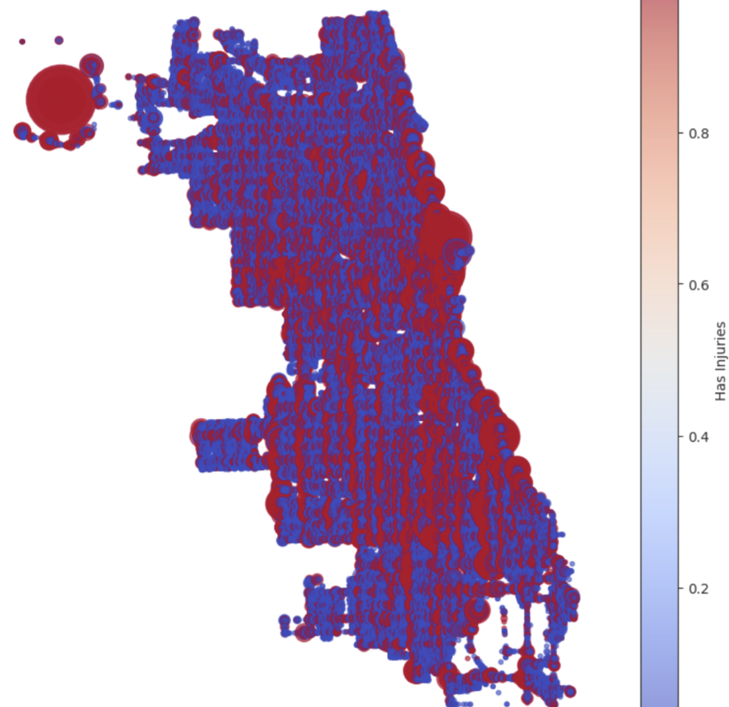
Crashes in Chicago

Slide 10
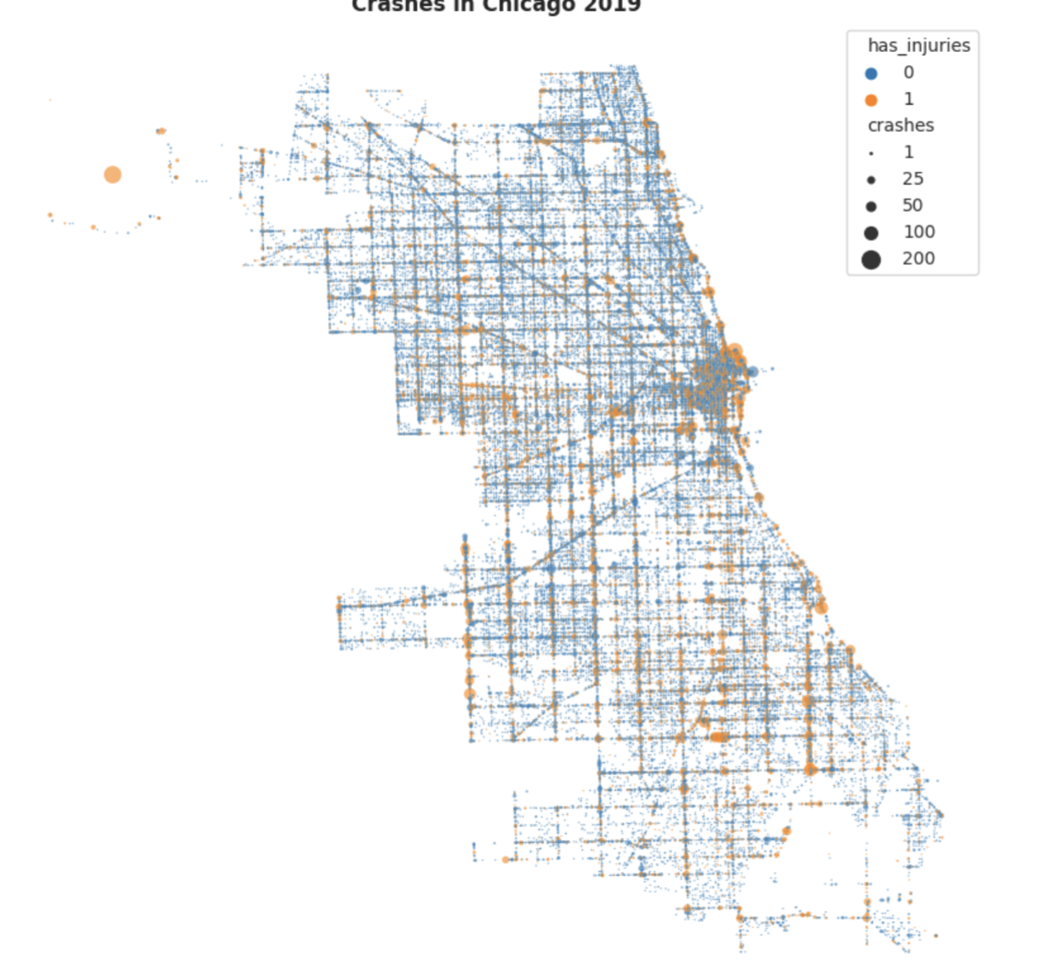
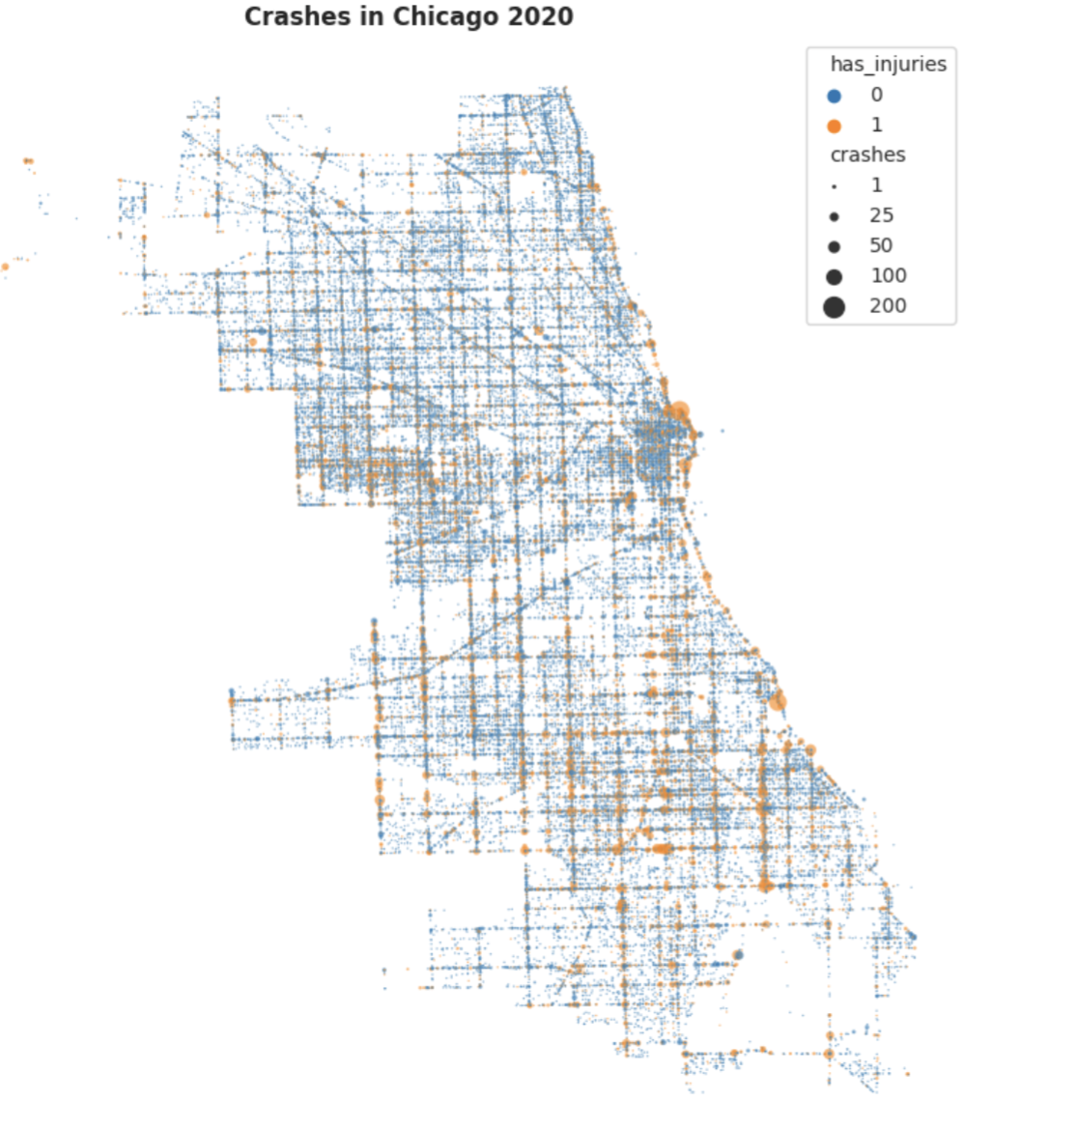
Crashes in Chicago in between 2019 and 2020

Slide 11
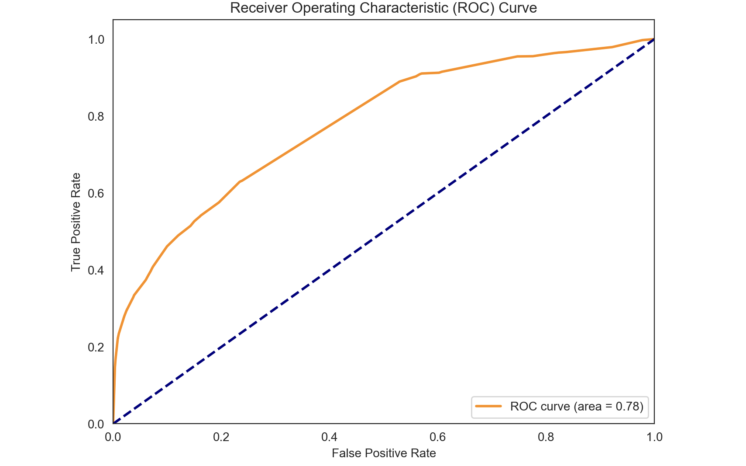
ROC CURVE

Slide 12
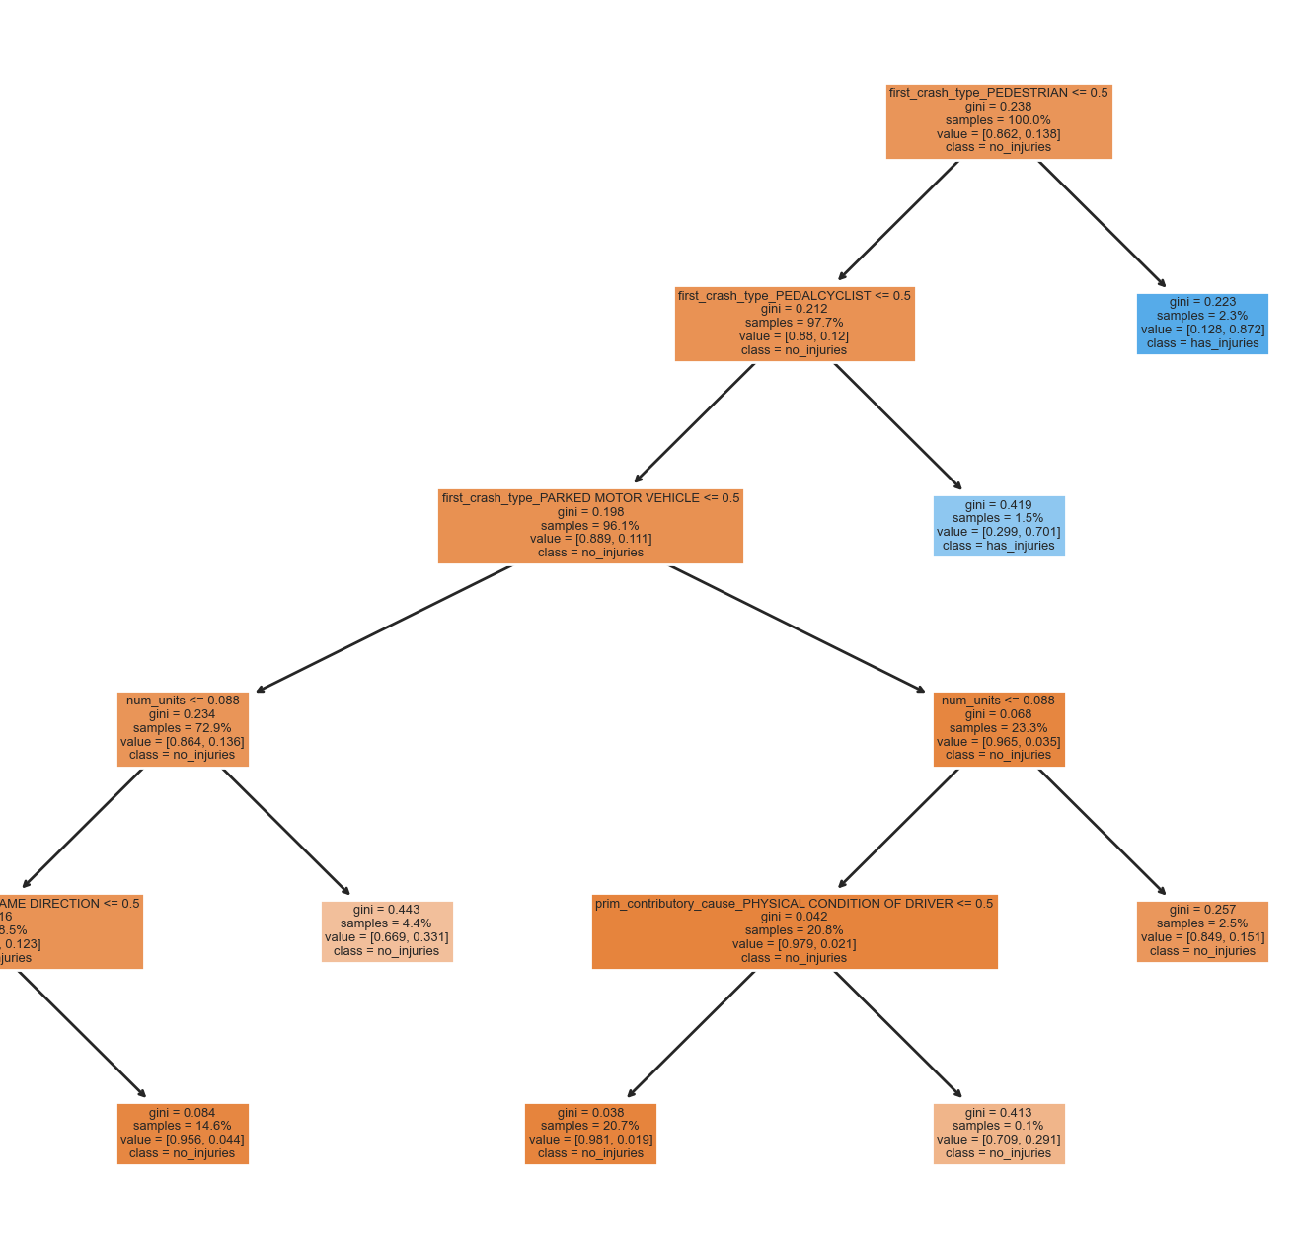
Decision tree Plots

Slide 13
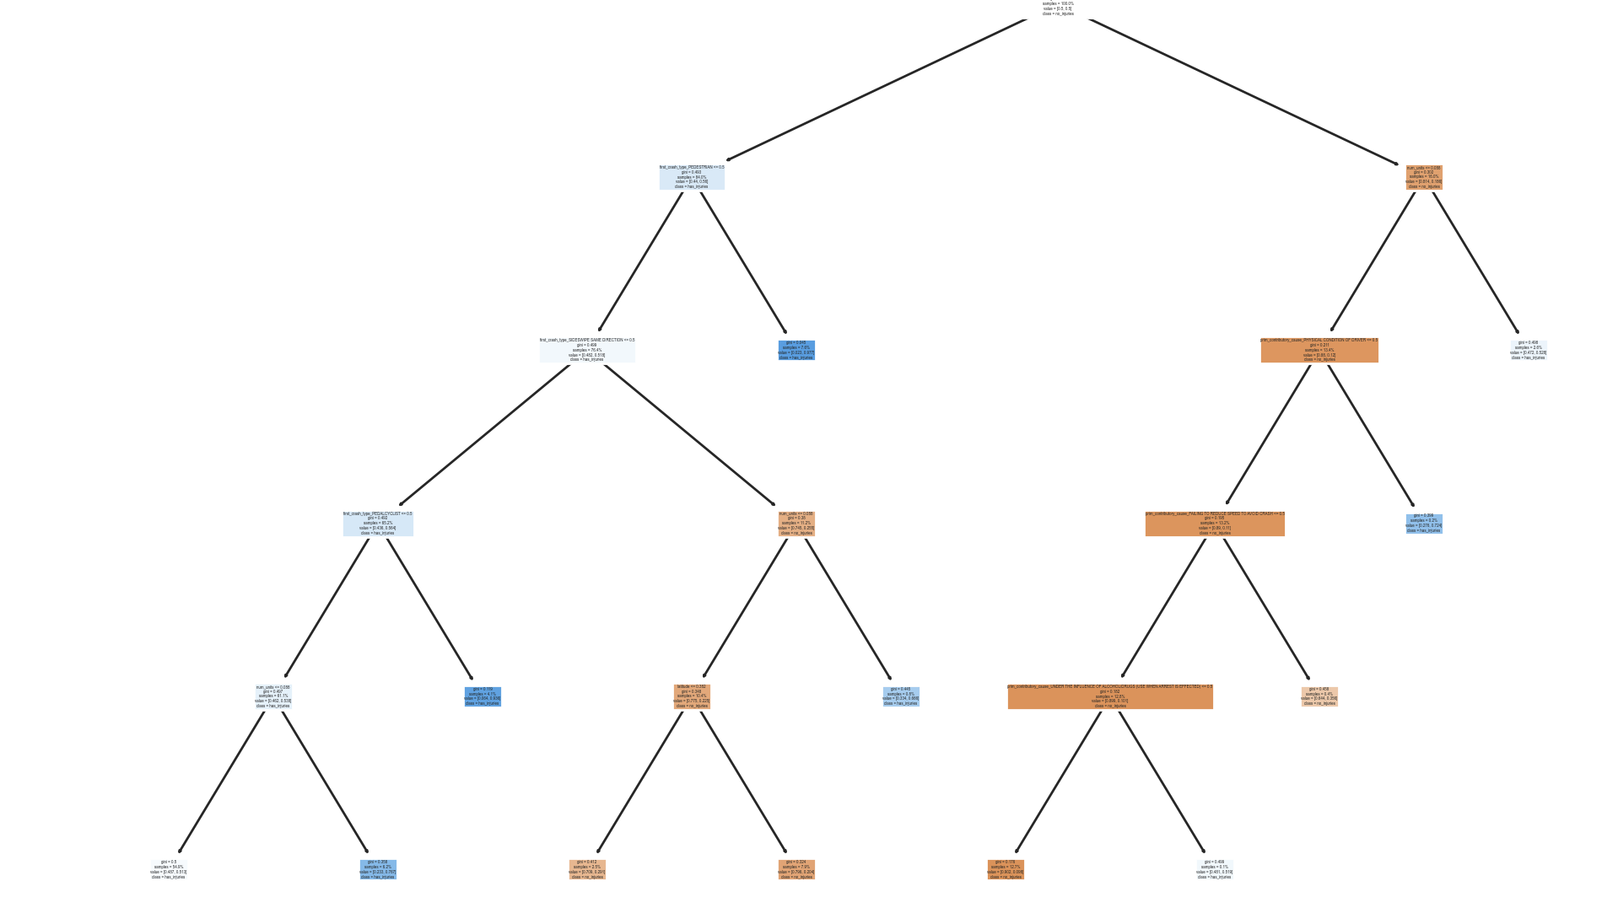

Slide 14

Thank you

